Slide 1
Chapter 18 : Concurrency Control
Modified
By
Khomsun Singhirunnusorn

Slide 2
Lock-Based Protocols
A lock is a mechanism to control concurrent access to a data item
Data items can be locked in two modes :
1. exclusive (X) mode. Data item can be both read as well as
written. X-lock is requested using lock-X instruction.
2. shared (S) mode. Data item can only be read. S-lock is
requested using lock-S instruction.
Lock requests are made to concurrency-control manager. Transaction can proceed only after request is granted.

Slide 3
Lock-Based Protocols (Cont.)
Lock-compatibility matrix
A transaction may be granted a lock on an item if the requested lock is compatible with locks already held on the item by other transactions
Any number of transactions can hold shared locks on an item,
But if any transaction holds an exclusive on the item no other transaction may hold any lock on the item.
Notes:
If a lock cannot be granted, the requesting transaction is made to wait till all incompatible locks held by other transactions have been released. The lock is then granted.

Slide 4
Lock-Based Protocols (Cont.)
Example of a transaction performing locking:
T₂: lock-S(A);
read (A);
unlock(A);
lock-S(B);
read (B);
unlock(B);
display(A+B)
Locking as above is not sufficient to guarantee serializability

Slide 5
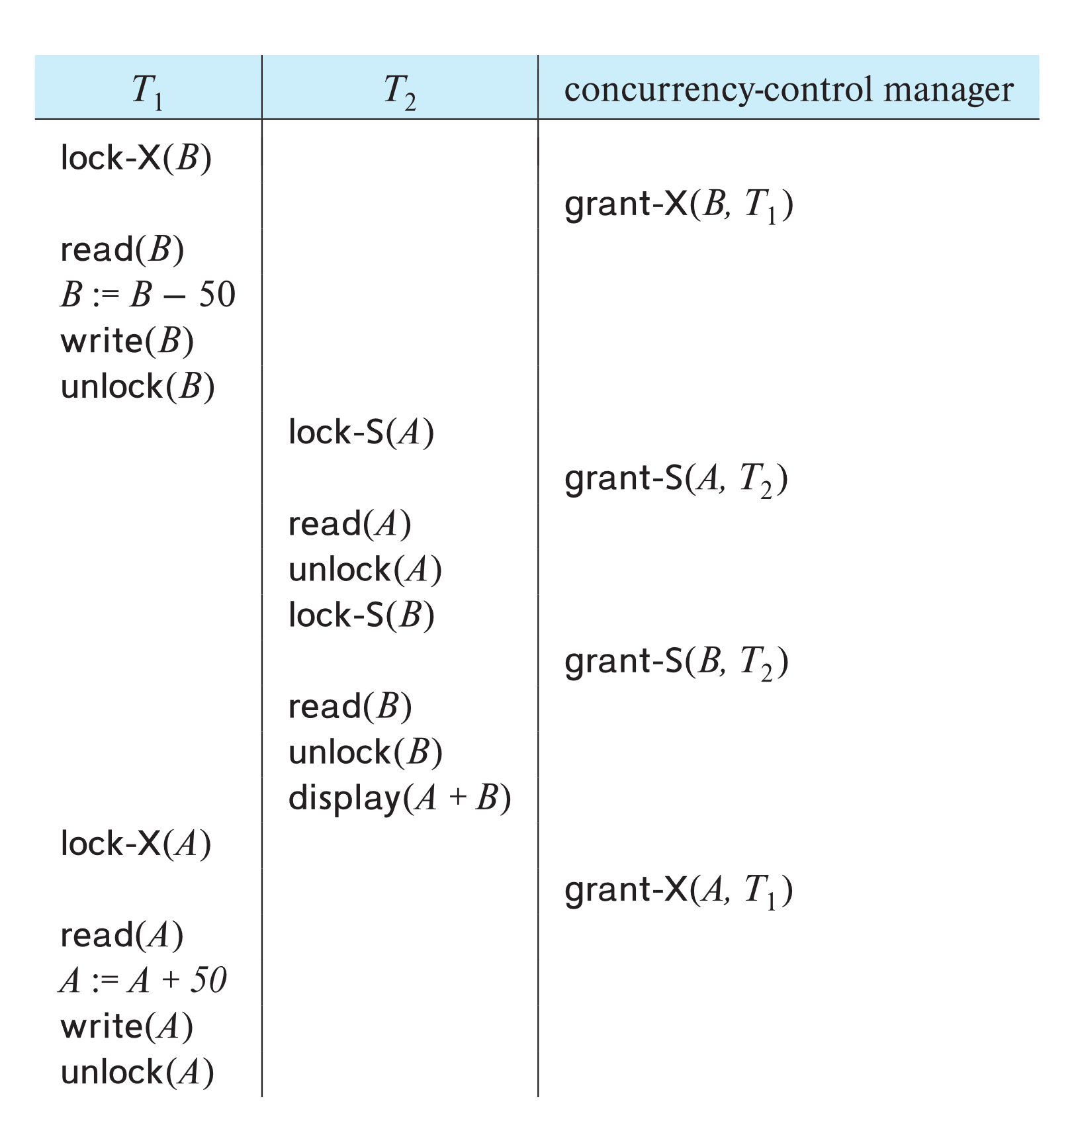
Schedule With Lock Grants
Grants omitted in rest of chapter
Assume grant happens just before the next instruction following lock request
This schedule is not serializable (why?)
A locking protocol is a set of rules followed by all transactions while requesting and releasing locks.
Locking protocols enforce serializability by restricting the set of possible schedules.

Slide 6
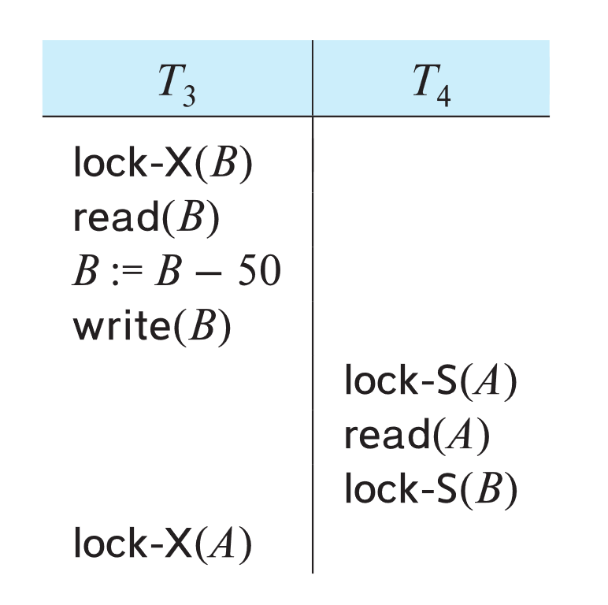
Deadlock
Consider the partial schedule
Neither T₃ nor T₄ can make progress — executing lock-S(B) causes T₄ to wait for T₃ to release its lock on B, while executing lock-X(A) causes T₃ to wait for T₄ to release its lock on A.
Such a situation is called a deadlock.
To handle a deadlock one of T₃ or T₄ must be rolled back and its locks released.

Slide 7
Deadlock (Cont.)
The potential for deadlock exists in most locking protocols. Deadlocks are a necessary evil.
Starvation is also possible if concurrency control manager is badly designed. For example:
A transaction may be waiting for an X-lock on an item, while a sequence of other transactions request and are granted an S-lock on the same item.
The same transaction is repeatedly rolled back due to deadlocks.
Concurrency control manager can be designed to prevent starvation.

Slide 8
The Two-Phase Locking Protocol
A protocol which ensures conflict-serializable schedules.
Phase 1: Growing Phase
Transaction may obtain locks
Transaction may not release locks
Phase 2: Shrinking Phase
Transaction may release locks
Transaction may not obtain locks
The protocol assures serializability. It can be proved that the transactions can be serialized in the order of their lock points (i.e., the point where a transaction acquired its final lock).
Locks
Time

Slide 9
The Two-Phase Locking Protocol (Cont.)
Two-phase locking does not ensure freedom from deadlocks
Extensions to basic two-phase locking needed to ensure recoverability of freedom from cascading roll-back
Strict two-phase locking: a transaction must hold all its exclusive locks till it commits/aborts.
Ensures recoverability and avoids cascading roll-backs
Rigorous two-phase locking: a transaction must hold all locks till commit/abort.
Transactions can be serialized in the order in which they commit.
Most databases implement rigorous two-phase locking, but refer to it as simply two-phase locking

Slide 10
The Two-Phase Locking Protocol (Cont.)
Two-phase locking is not a necessary condition for serializability
There are conflict serializable schedules that cannot be obtained if the two-phase locking protocol is used.
In the absence of extra information (e.g., ordering of access to data), two-phase locking is necessary for conflict serializability in the following sense:
Given a transaction T_{i} that does not follow two-phase locking, we can find a transaction T_{j} that uses two-phase locking, and a schedule for T_{i} and T_{j} that is not conflict serializable.

Slide 11
Locking Protocols
Given a locking protocol (such as 2PL)
A schedule S is legal under a locking protocol if it can be generated by a set of transactions that follow the protocol
A protocol ensures serializability if all legal schedules under that protocol are serializable

Slide 12
Lock Conversions
Two-phase locking protocol with lock conversions:
– Growing Phase:
can acquire a lock-S on item
can acquire a lock-X on item
can convert a lock-S to a lock-X (upgrade)
– Shrinking Phase:
can release a lock-S
can release a lock-X
can convert a lock-X to a lock-S (downgrade)
This protocol ensures serializability

Slide 13
Automatic Acquisition of Locks
A transaction T_{i} issues the standard read/write instruction, without explicit locking calls.
The operation read(D) is processed as:
if T_{i} has a lock on D
then
read(D)
else begin
if necessary wait until no other
transaction has a lock-X on D
grant T_{i} a lock-S on D;
read(D)
end

Slide 14
Automatic Acquisition of Locks (Cont.)
The operation write(D) is processed as:
if T_{i} has a lock-X on D
then
write(D)
else begin
if necessary wait until no other trans. has any lock on D,
if T_{i} has a lock-S on D
then
upgrade lock on D to lock-X
else
grant T_{i} a lock-X on D
write(D)
end;
All locks are released after commit or abort

Slide 15
Implementation of Locking
A lock manager can be implemented as a separate process
Transactions can send lock and unlock requests as messages
The lock manager replies to a lock request by sending a lock grant messages (or a message asking the transaction to roll back, in case of a deadlock)
The requesting transaction waits until its request is answered
The lock manager maintains an in-memory data-structure called a lock table to record granted locks and pending requests

Slide 16
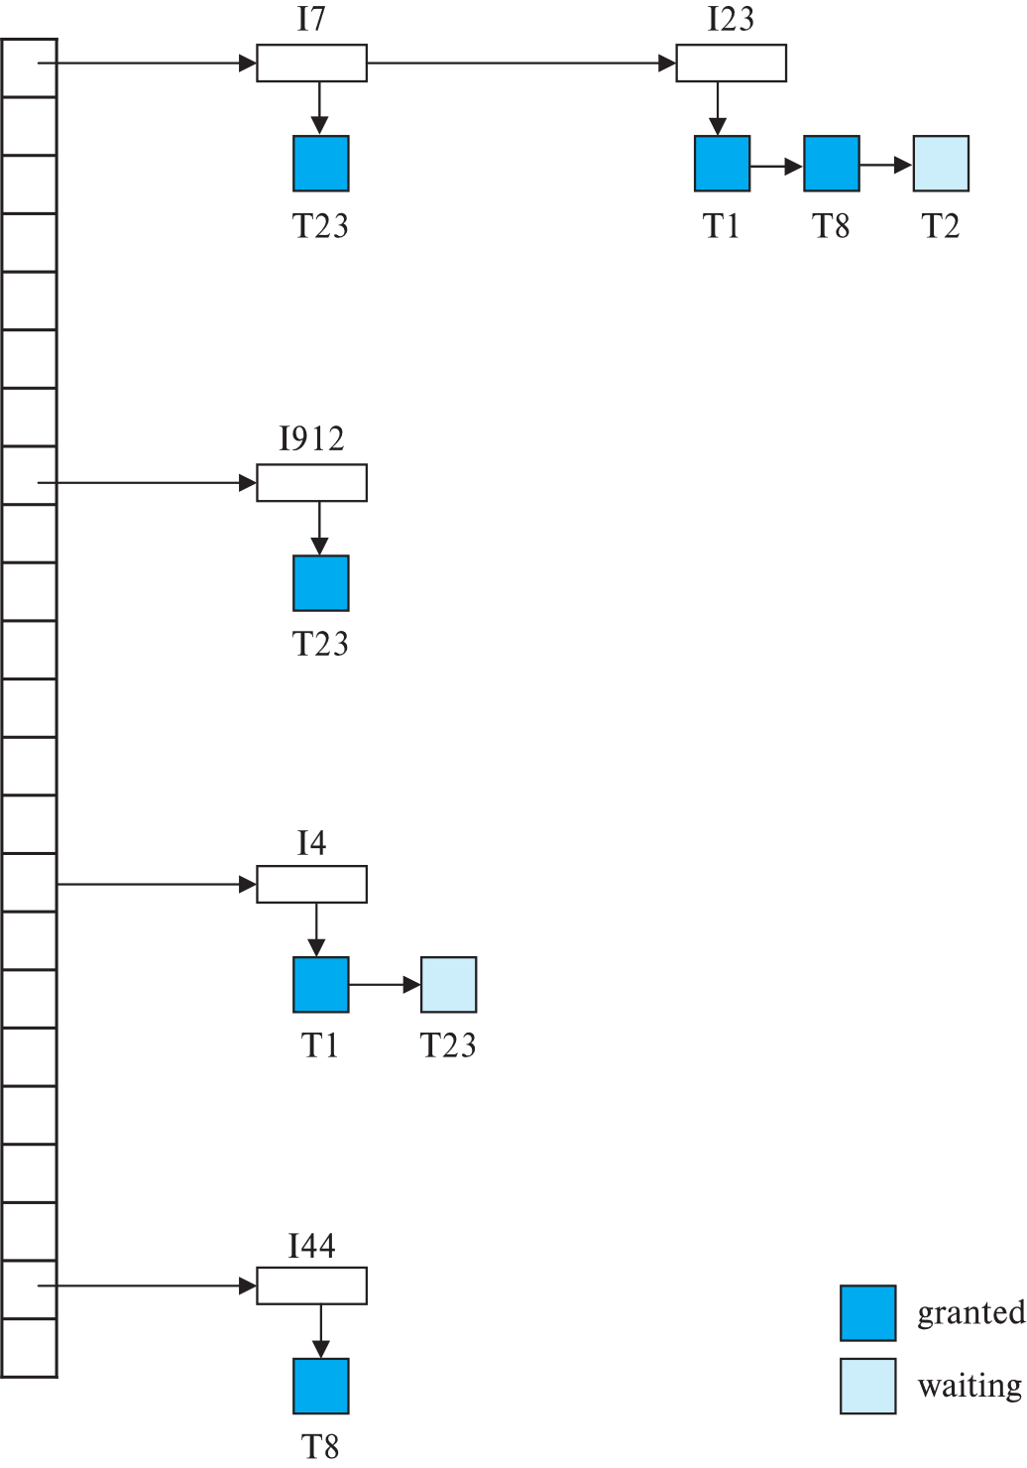
Lock Table
Dark rectangles indicate granted locks, light colored ones indicate waiting requests
Lock table also records the type of lock granted or requested
New request is added to the end of the queue of requests for the data item, and granted if it is compatible with all earlier locks
Unlock requests result in the request being deleted, and later requests are checked to see if they can now be granted
If transaction aborts, all waiting or granted requests of the transaction are deleted
lock manager may keep a list of locks held by each transaction, to implement this efficiently

Slide 17
Graph-Based Protocols
Graph-based protocols are an alternative to two-phase locking
Impose a partial ordering → on the set D = {d₁, d₂ ,..., d_{h}} of all data items.
If d_{i} → d_{j} then any transaction accessing both d_{i} and d_{j} must access d_{i} before accessing d_{j}.
Implies that the set D may now be viewed as a directed acyclic graph, called a database graph.
The tree-protocol is a simple kind of graph protocol.

Slide 18
Tree Protocol
Only exclusive locks are allowed.
The first lock by T_{i} may be on any data item. Subsequently, a data Q can be locked by T_{i} only if the parent of Q is currently locked by T_{i}.
Data items may be unlocked at any time.
A data item that has been locked and unlocked by T_{i} cannot subsequently be relocked by T_{i}

Slide 19
Graph-Based Protocols (Cont.)
The tree protocol ensures conflict serializability as well as freedom from deadlock.
Unlocking may occur earlier in the tree-locking protocol than in the two-phase locking protocol.
Shorter waiting times, and increase in concurrency
Protocol is deadlock-free, no rollbacks are required
Drawbacks
Protocol does not guarantee recoverability or cascade freedom
Need to introduce commit dependencies to ensure recoverability
Transactions may have to lock data items that they do not access.
increased locking overhead, and additional waiting time
potential decrease in concurrency
Schedules not possible under two-phase locking are possible under the tree protocol, and vice versa.

Slide 20
Deadlock Handling
System is deadlocked if there is a set of transactions such that every transaction in the set is waiting for another transaction in the set.

Slide 21
Deadlock Handling
Deadlock prevention protocols ensure that the system will never enter into a deadlock state. Some prevention strategies:
Require that each transaction locks all its data items before it begins execution (pre-declaration).
Impose partial ordering of all data items and require that a transaction can lock data items only in the order specified by the partial order (graph-based protocol).

Slide 22
More Deadlock Prevention Strategies
wait-die scheme — non-preemptive
Older transaction may wait for younger one to release data item.
Younger transactions never wait for older ones; they are rolled back instead.
A transaction may die several times before acquiring a lock
wound-wait scheme — preemptive
Older transaction wounds (forces rollback) of younger transaction instead of waiting for it.
Younger transactions may wait for older ones.
Fewer rollbacks than wait-die scheme.
In both schemes, a rolled back transactions is restarted with its original timestamp.
Ensures that older transactions have precedence over newer ones, and starvation is thus avoided.

Slide 23
Deadlock prevention (Cont.)
Timeout-Based Schemes:
A transaction waits for a lock only for a specified amount of time. After that, the wait times out and the transaction is rolled back.
Ensures that deadlocks get resolved by timeout if they occur
Simple to implement
But may roll back transaction unnecessarily in absence of deadlock
Difficult to determine good value of the timeout interval.
Starvation is also possible

Slide 24
Deadlock Detection
Wait-for graph
Vertices: transactions
Edge from T_{i} →T_{j}. : if T_{i} is waiting for a lock held in conflicting mode byT_{j}
The system is in a deadlock state if and only if the wait-for graph has a cycle.
Invoke a deadlock-detection algorithm periodically to look for cycles.
Wait-for graph without a cycle
Wait-for graph with a cycle

Slide 25
Deadlock Recovery
When deadlock is detected :
Some transaction will have to rolled back (made a victim) to break deadlock cycle.
Select that transaction as victim that will incur minimum cost
Rollback -- determine how far to roll back transaction
Total rollback: Abort the transaction and then restart it.
Partial rollback: Roll back victim transaction only as far as necessary to release locks that another transaction in cycle is waiting for
Starvation can happen (why?)
One solution: oldest transaction in the deadlock set is never chosen as victim

Slide 26
Multiple Granularity
Allow data items to be of various sizes and define a hierarchy of data granularities, where the small granularities are nested within larger ones
Can be represented graphically as a tree (but don't confuse with tree-locking protocol)
When a transaction locks a node in the tree explicitly, it implicitly locks all the node's descendants in the same mode.
Granularity of locking (level in tree where locking is done):
Fine granularity (lower in tree): high concurrency, high locking overhead
Coarse granularity (higher in tree): low locking overhead, low concurrency

Slide 27
Example of Granularity Hierarchy
The levels, starting from the coarsest (top) level are
database
area
file
record

Slide 28
Example of Granularity Hierarchy
The levels, starting from the coarsest (top) level are
database
area
file
record
The corresponding tree

Slide 29
Intention Lock Modes
In addition to S and X lock modes, there are three additional lock modes with multiple granularity:
intention-shared (IS): indicates explicit locking at a lower level of the tree but only with shared locks.
intention-exclusive (IX): indicates explicit locking at a lower level with exclusive or shared locks
shared and intention-exclusive (SIX): the subtree rooted by that node is locked explicitly in shared mode and explicit locking is being done at a lower level with exclusive-mode locks.
Intention locks allow a higher level node to be locked in S or X mode without having to check all descendent nodes.

Slide 30
Compatibility Matrix with Intention Lock Modes
The compatibility matrix for all lock modes is:

Slide 31
Multiple Granularity Locking Scheme
Transaction T_{i} can lock a node Q, using the following rules:
The lock compatibility matrix must be observed.
2. The root of the tree must be locked first, and may be locked in any
mode.
3. A node Q can be locked by T_{i} in S or IS mode only if the parent of Q is
currently locked by T_{i} in either IX or IS mode.
4. A node Q can be locked by T_{i} in X, SIX, or IX mode only if the parent
of Q is currently locked by T_{i} in either IX or SIX mode.
5. T_{i} can lock a node only if it has not previously unlocked any node (that
is, T_{i} is two-phase).
6. T_{i} can unlock a node Q only if none of the children of Q are currently
locked by T_{i}.
Observe that locks are acquired in root-to-leaf order, whereas they are released in leaf-to-root order.
Lock granularity escalation: in case there are too many locks at a particular level, switch to higher granularity S or X lock

Slide 32
Insert/Delete Operations and Predicate Reads
Locking rules for insert/delete operations
An exclusive lock must be obtained on an item before it is deleted
A transaction that inserts a new tuple into the database I automatically given an X-mode lock on the tuple
Ensures that
reads/writes conflict with deletes
Inserted tuple is not accessible by other transactions until the transaction that inserts the tuple commits

Slide 33
Phantom Phenomenon
Example of phantom phenomenon.
A transaction T1 that performs predicate read (or scan) of a relation
select count(*) from instructor where dept_name = 'Physics'
and a transaction T2 that inserts a tuple while T1 is active but after predicate read
insert into instructor values ('11111', 'Feynman', 'Physics', 94000)
(conceptually) conflict in spite of not accessing any tuple in common.
If only tuple locks are used, non-serializable schedules can result
E.g. the scan transaction does not see the new instructor, but may read some other tuple written by the update transaction
Can also occur with updates
E.g. update Wu’s department from Finance to Physics

Slide 34
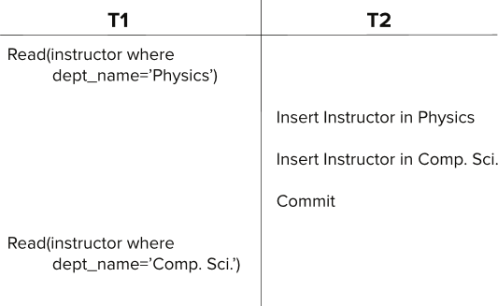
Insert/Delete Operations and Predicate Reads
Another Example: T1 and T2 both find maximum instructor ID in parallel, and create new instructors with ID = maximum ID + 1
Both instructors get same ID, not possible in serializable schedule
Schedule

Slide 35
Handling Phantoms
There is a conflict at the data level
The transaction performing predicate read or scanning the relation is reading information that indicates what tuples the relation contains
The transaction inserting/deleting/updating a tuple updates the same information.
The conflict should be detected, e.g. by locking the information.
One solution:
Associate a data item with the relation, to represent the information about what tuples the relation contains.
Transactions scanning the relation acquire a shared lock in the data item,
Transactions inserting or deleting a tuple acquire an exclusive lock on the data item. (Note: locks on the data item do not conflict with locks on individual tuples.)
Above protocol provides very low concurrency for insertions/deletions.

Slide 36
Index Locking To Prevent Phantoms
Index locking protocol to prevent phantoms
Every relation must have at least one index.
A transaction can access tuples only after finding them through one or more indices on the relation
A transaction T_{i} that performs a lookup must lock all the index leaf nodes that it accesses, in S-mode
Even if the leaf node does not contain any tuple satisfying the index lookup (e.g. for a range query, no tuple in a leaf is in the range)
A transaction T_{i} that inserts, updates or deletes a tuple t_{i} in a relation r
Must update all indices to r
Must obtain exclusive locks on all index leaf nodes affected by the insert/update/delete
The rules of the two-phase locking protocol must be observed
Guarantees that phantom phenomenon won’t occur

Slide 37
Next-Key Locking to Prevent Phantoms
Index-locking protocol to prevent phantoms locks entire leaf node
Can result in poor concurrency if there are many inserts
Next-key locking protocol: provides higher concurrency
Lock all values that satisfy index lookup (match lookup value, or fall in lookup range)
Also lock next key value in index
even for inserts/deletes
Lock mode: S for lookups, X for insert/delete/update
Ensures detection of query conflicts with inserts, deletes and updates
Consider B+-tree leaf nodes as below, with query predicate 7 $≤$ X $≤$ 16. Check what happens with next-key locking when inserting: (i) 15 and (ii) 7

Slide 38
Timestamp Based Concurrency Control

Slide 39
Timestamp-Based Protocols
Each transaction T_{i} is issued a timestamp TS(T_{i}) when it enters the system.
Each transaction has a unique timestamp
Newer transactions have timestamps strictly greater than earlier ones
Timestamp could be based on a logical counter
Real time may not be unique
Can use (wall-clock time, logical counter) to ensure
Timestamp-based protocols manage concurrent execution such that time-stamp order = serializability order
Several alternative protocols based on timestamps

Slide 40
Timestamp-Ordering Protocol
The timestamp ordering (TSO) protocol
Maintains for each data Q two timestamp values:
W-timestamp(Q) is the largest time-stamp of any transaction that executed write(Q) successfully.
R-timestamp(Q) is the largest time-stamp of any transaction that executed read(Q) successfully.
Imposes rules on read and write operations to ensure that
Any conflicting operations are executed in timestamp order
Out of order operations cause transaction rollback

Slide 41
Timestamp-Based Protocols (Cont.)
Suppose a transaction T_{i} issues a read(Q)
1. If TS(T_{i}) < W-timestamp(Q), then T_{i} needs to read a value of Q that
was already overwritten.
Hence, the read operation is rejected, and T_{i} is rolled back.
2. If TS(T_{i}) ≥ W-timestamp(Q), then the read operation is executed, and
R-timestamp(Q) is set to
max(R-timestamp(Q), TS(T_{i})).

Slide 42
Timestamp-Based Protocols (Cont.)
Suppose that transaction T_{i} issues write(Q).
1. If TS(T_{i}) < R-timestamp(Q), then the value of Q that T_{i} is producing
was needed previously, and the system assumed that that value
would never be produced.
Hence, the write operation is rejected, and T_{i} is rolled back.
2. If TS(T_{i}) < W-timestamp(Q), then T_{i} is attempting to write an
obsolete value of Q.
Hence, this write operation is rejected, and T_{i} is rolled back.
3. Otherwise, the write operation is executed, and W-timestamp(Q) is
set to TS(T_{i}).

Slide 43
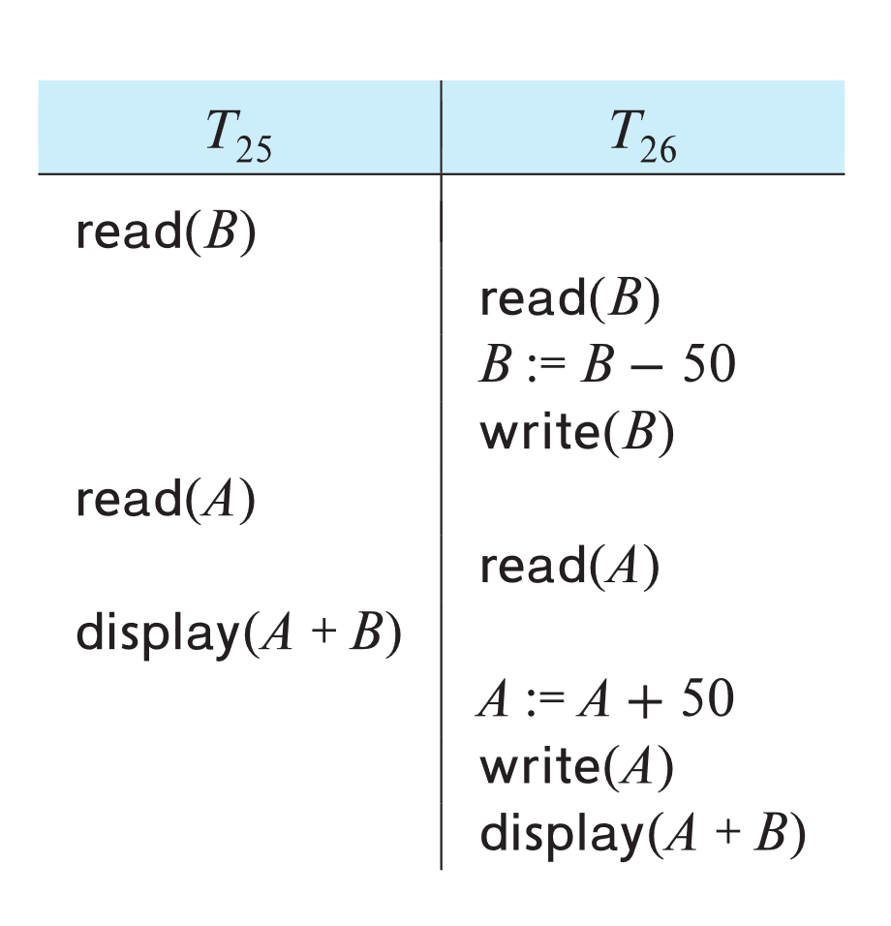
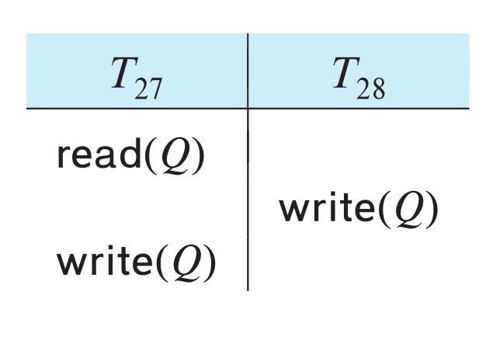
Example of Schedule Under TSO
Is this schedule valid under TSO?
Assume that initially:
R-TS(A) = W-TS(A) = 0
R-TS(B) = W-TS(B) = 0
Assume TS(T₂₅) = 25 and TS(T₂₆) = 26
How about this one, where initially R-TS(Q)=W-TS(Q)=0

Slide 44
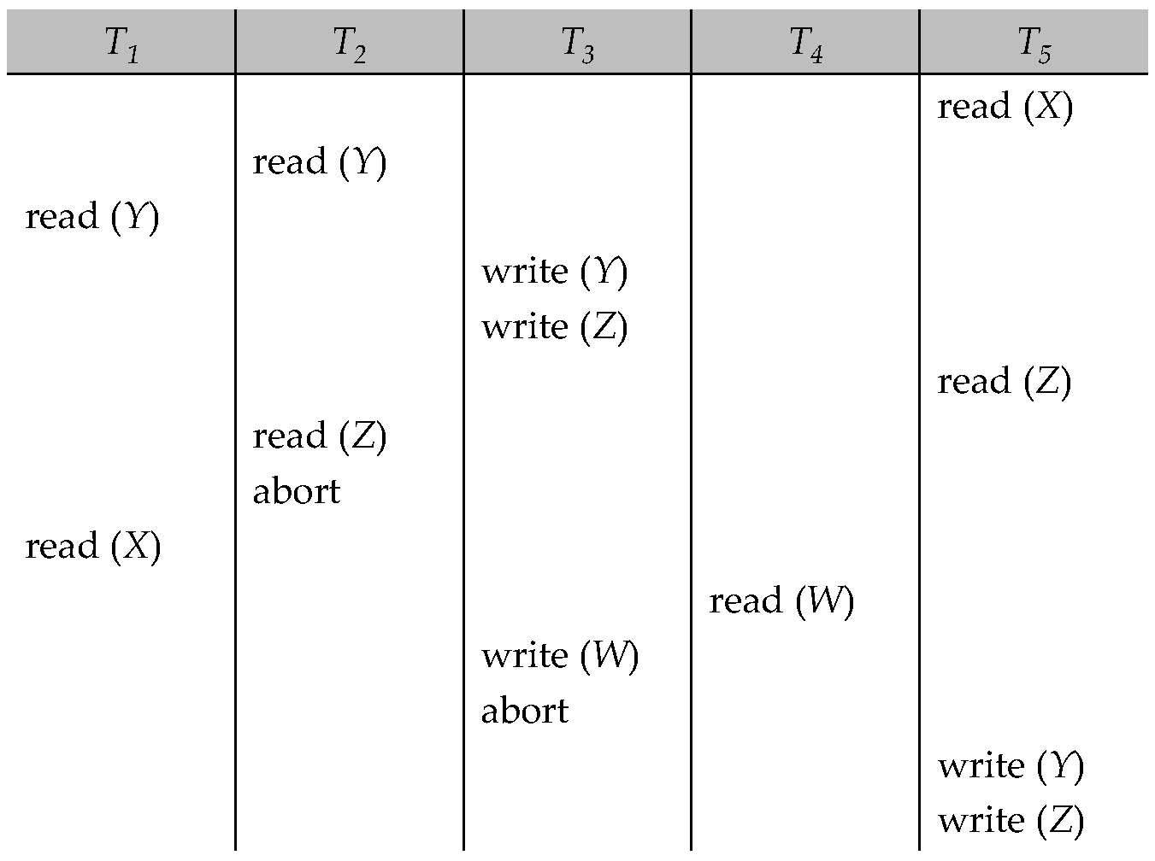
Another Example Under TSO
A partial schedule for several data items for transactions with
timestamps 1, 2, 3, 4, 5, with all R-TS and W-TS = 0 initially

Slide 45
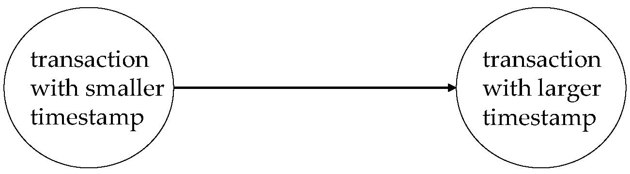
Correctness of Timestamp-Ordering Protocol
The timestamp-ordering protocol guarantees serializability since all the arcs in the precedence graph are of the form:
Thus, there will be no cycles in the precedence graph
Timestamp protocol ensures freedom from deadlock as no transaction ever waits.
But the schedule may not be cascade-free, and may not even be recoverable.

Slide 46
Recoverability and Cascade Freedom
Solution 1:
A transaction is structured such that its writes are all performed at the end of its processing
All writes of a transaction form an atomic action; no transaction may execute while a transaction is being written
A transaction that aborts is restarted with a new timestamp
Solution 2:
Limited form of locking: wait for data to be committed before reading it
Solution 3:
Use commit dependencies to ensure recoverability

Slide 47
Thomas’ Write Rule
Modified version of the timestamp-ordering protocol in which obsolete write operations may be ignored under certain circumstances.
When T_{i} attempts to write data item Q, if TS(T_{i}) < W-timestamp(Q), then T_{i} is attempting to write an obsolete value of {Q}.
Rather than rolling back T_{i} as the timestamp ordering protocol would have done, this {write} operation can be ignored.
Otherwise this protocol is the same as the timestamp ordering protocol.
Thomas' Write Rule allows greater potential concurrency.
Allows some view-serializable schedules that are not conflict-serializable.

Slide 48
Validation-Based Protocol
Idea: can we use commit time as serialization order?
To do so:
Postpone writes to end of transaction
Keep track of data items read/written by transaction
Validation performed at commit time, detect any out-of-serialization order reads/writes
Also called as optimistic concurrency control since transaction executes fully in the hope that all will go well during validation

Slide 49
Validation-Based Protocol
Execution of transaction T_{i} is done in three phases.
1. Read and execution phase: Transaction T_{i} writes only to
temporary local variables
2. Validation phase: Transaction T_{i} performs a '‘validation test''
to determine if local variables can be written without violating
serializability.
3. Write phase: If T_{i} is validated, the updates are applied to the
database; otherwise, T_{i} is rolled back.
The three phases of concurrently executing transactions can be interleaved, but each transaction must go through the three phases in that order.
We assume for simplicity that the validation and write phase occur together, atomically and serially
I.e., only one transaction executes validation/write at a time.

Slide 50
Validation-Based Protocol (Cont.)
Each transaction T_{i} has 3 timestamps
StartTS(T_{i}) : the time when T_{i} started its execution
ValidationTS(T_{i}): the time when T_{i} entered its validation phase
FinishTS(T_{i}) : the time when T_{i} finished its write phase
Validation tests use above timestamps and read/write sets to ensure that serializability order is determined by validation time
Thus, TS(T_{i}) = ValidationTS(T_{i})
Validation-based protocol has been found to give greater degree of concurrency than locking/TSO if probability of conflicts is low.

Slide 51
Validation Test for Transaction T_{j}
If for all T_{i} with TS (T_{i}) < TS (T_{j}) either one of the following condition holds:
finishTS(T_{i}) < startTS(T_{j})
startTS(T_{j}) < finishTS(T_{i}) < validationTS(T_{j}) and the set of data items written by T_{i} does not intersect with the set of data items read by T_{j}.
then validation succeeds and T_{j} can be committed.
Otherwise, validation fails and T_{j} is aborted.
Justification:
First condition applies when execution is not concurrent
The writes of T_{j} do not affect reads of T_{i} since they occur after T_{i} has finished its reads.
If the second condition holds, execution is concurrent, T_{j} does not read any item written by T_{i}.

Slide 52
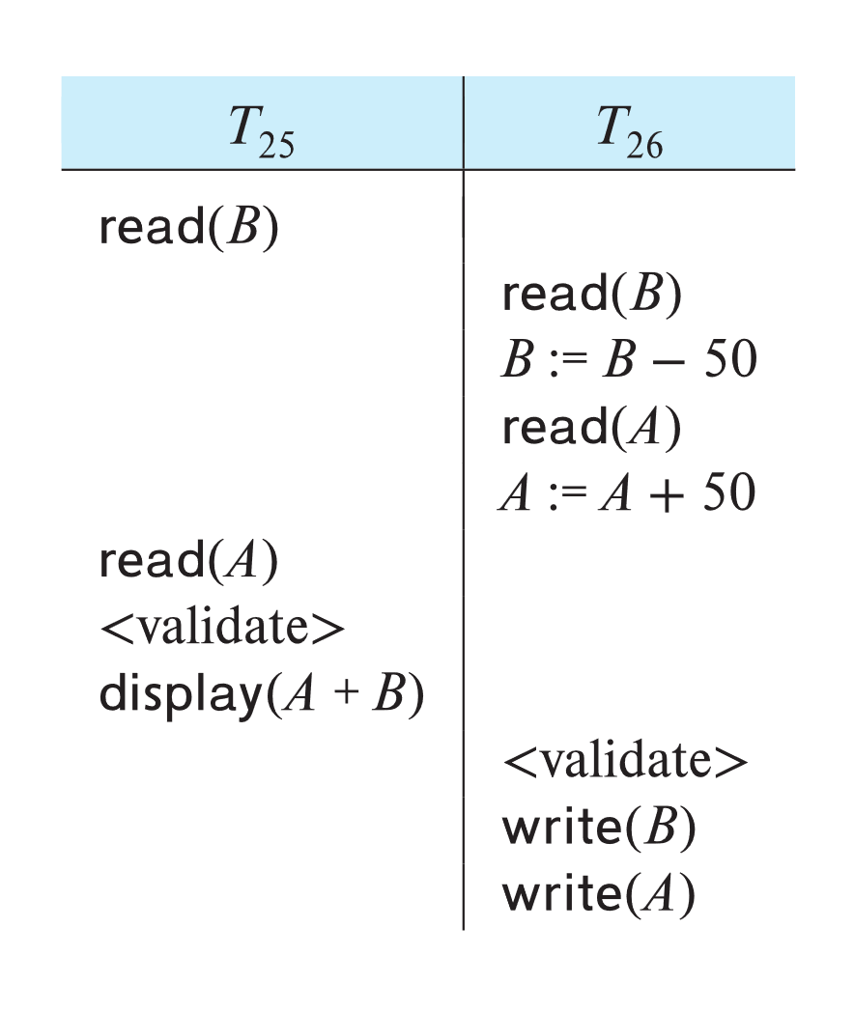
Schedule Produced by Validation
Example of schedule produced using validation

Slide 53
View Serializability
Let S and S´ be two schedules with the same set of transactions. S and S´ are view equivalent if the following three conditions are met, for each data item Q,
1. If in schedule S, transaction T_{i} reads the initial value of Q, then in
schedule S’ also transaction T_{i} must read the initial value of Q.
2. If in schedule S transaction T_{i} executes read(Q), and that value was
produced by transaction T_{j} (if any), then in schedule S’ also
transaction T_{i} must read the value of Q that was produced by the
same write(Q) operation of transaction T_{j} .
3. The transaction (if any) that performs the final write(Q) operation in
schedule S must also perform the final write(Q) operation in schedule
S’.
As can be seen, view equivalence is also based purely on reads and writes alone.

Slide 54
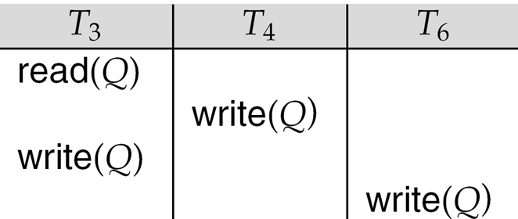
View Serializability (Cont.)
A schedule S is view serializable if it is view equivalent to a serial schedule.
Every conflict serializable schedule is also view serializable.
Below is a schedule which is view-serializable but not conflict serializable.
What serial schedule is above equivalent to?
Every view serializable schedule that is not conflict serializable has blind writes.

Slide 55
Test for View Serializability
The precedence graph test for conflict serializability cannot be used directly to test for view serializability.
Extension to test for view serializability has cost exponential in the size of the precedence graph.
The problem of checking if a schedule is view serializable falls in the class of NP-complete problems.
Thus, existence of an efficient algorithm is extremely unlikely.
However practical algorithms that just check some sufficient conditions for view serializability can still be used.

Slide 56
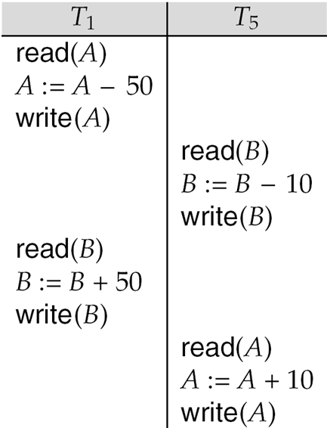
Other Notions of Serializability
The schedule below produces same outcome as the serial schedule < T₁, T₅ >, yet is not conflict equivalent or view equivalent to it.
Determining such equivalence requires analysis of operations other than read and write.
Operation-conflicts, operation locks

